Slide 1
HOUSEKEEPER SCHEDULING SYSTEM
230 JAVA(SL VA) RLL GROUP-1

Slide 2
PROJECT MEMBERS
Aman Kumar Singh
Patan Anju
Raj Kumar Yadav
Anjaly Jaikumar
B Sai Charan
Bikki Mahesh
Chaithra S
Kummara Thanmai
Srishti Daga

Slide 3
CONTENTS
Introduction
Tools and Technologies
Admin
Student
Microservice Architecture
Services
Interaction of Services
Spring Cloud

Slide 4
INTRODUCTION
The HOUSEKEEPER SCHEDULING SYSTEM is designed to ensure timely room cleaning for hostel students.
Admin selects housekeepers, assigns specific requests from students, and can register new housekeepers based on floor no.
The system manages housekeeper details, including name, hostel, floor, rooms cleaned, and feedback.
It also maintains user feedback and request status, enhancing efficiency and communication within the hostel environment.

Slide 5
Tools and Technologies
Server-side: Spring Boot, Spring Cloud, Spring Data JPA
Database: MySQL
Server: EmbeddedTomcat
DevOps: Docker, Git Hub
Spring Cloud: Spring Cloud Config, Spring Cloud Netflix Eureka, Feign, Resilience4j, Retry, Sleuth and Zipkin

Slide 6
Admin
Login
Allot HouseKeeper
View Feedbacks
Register Student
Register HouseKeeper

Slide 7
Student
Login
Request HouseKeeper
Feedback
Profile Update
Change Password

Slide 8
Microservices Architecture
Microservices is an approach to developing a single application as a suite of small services.
It allows large systems to be built up from a number of collaborating components.
It is like a game changer in application design, breaks down a complex system into smaller, independent services that can be developed, deployed and scaled individually.

Slide 9
SERVICES
Admin – AddStudent, AddWorker, AllotHousekeeper, View Feedbacks
Student – Raise Request, Send Feedback, Update Profile, ChangePassword

Slide 10
Microservice Architecture Look Like
Admin Service
Clean Request Service
Feedback Service
Student Service
Worker Service
DB
DB
DB
DB
DB

Slide 11
Interaction of Services
Microservice-1
Microservice-2
Microservice-3
Microservice-5
Microservice-4

Slide 12
Spring Cloud Config Server
Objective: Spring Cloud Config is a module that provides centralized externalized configuration management for microservices. It allows you to store configuration settings for multiple services in a central repository.
It helps in maintaining configuration consistency across multiple microservices and allows for dynamic configuration changes without the need to redeploy services.

Slide 13
Spring Cloud Netflix Eureka
Objective : Eureka is a service discovery and registration server. It allows microservices to register themselves and discover other services within a distributed system.
Eureka simplifies the process of service registration and discovery, enabling dynamic scaling and load balancing of microservices.

Slide 14
Feign
Objective: Feign is a declarative web service client for making HTTP requests to other microservices. It allows developers to define API interfaces using annotations, making it easier to interact with RESTful services.
Feign simplifies the consumption of RESTful services and can integrate seamlessly with other Spring Cloud components like Eureka for service discovery.

Slide 15
Resilience4j
Objective: Resilience4j is a lightweight fault tolerance library for Java. It helps developers implement resilience patterns such as circuit breakers, retries, rate limiting, and bulkheads in their microservices.
Resilience4j helps ensure that microservices can gracefully handle failures and transient issues, improving system reliability.

Slide 16
Retry
Objective: Retry is a component that can be used in conjunction with Resilience4j or independently. It provides mechanisms to retry failed operations, such as network requests or database queries.
Retry is useful when dealing with operations that may fail temporarily due to external factors like network glitches.

Slide 17
Sleuth
Objective: Sleuth is a distributed tracing system for Spring Boot applications. It generates trace and span IDs for requests, allowing you to track requests as they traverse multiple microservices.
Sleuth helps diagnose and troubleshoot issues in microservices architectures by providing insights into request flow and latency.

Slide 18
Zipkin
Objective: Zipkin is a distributed tracing system that works in conjunction with Sleuth. It collects and displays trace data, showing the path and timing of requests as they move through different microservices.
Zipkin aids in identifying performance bottlenecks and latency issues within a distributed system.

Slide 19
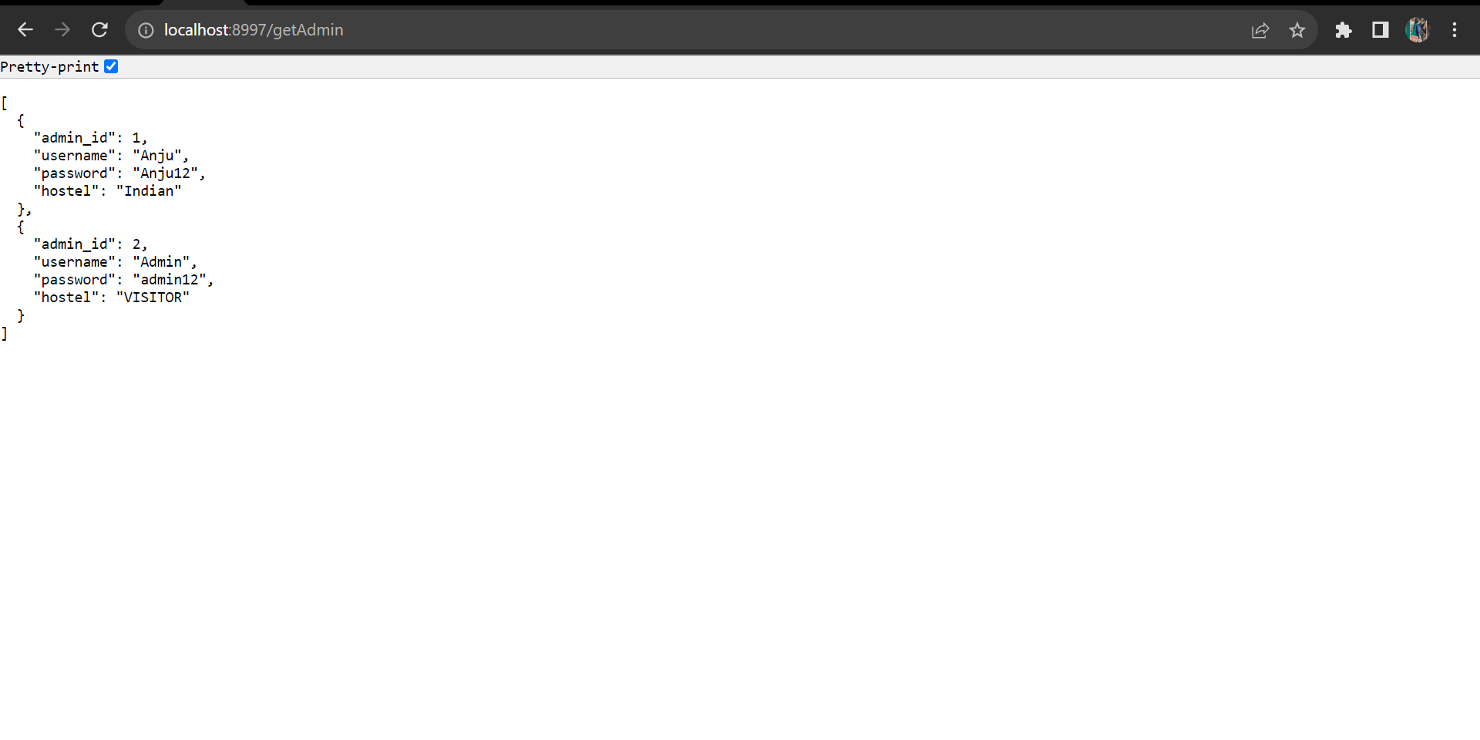
Output Screenshots
getAdmin

Slide 20
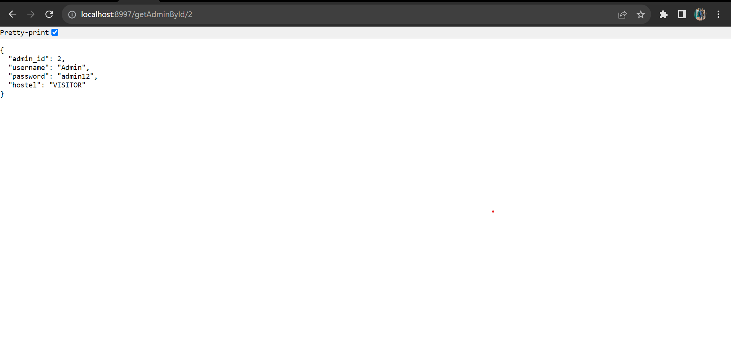
getAdminById/2

Slide 21
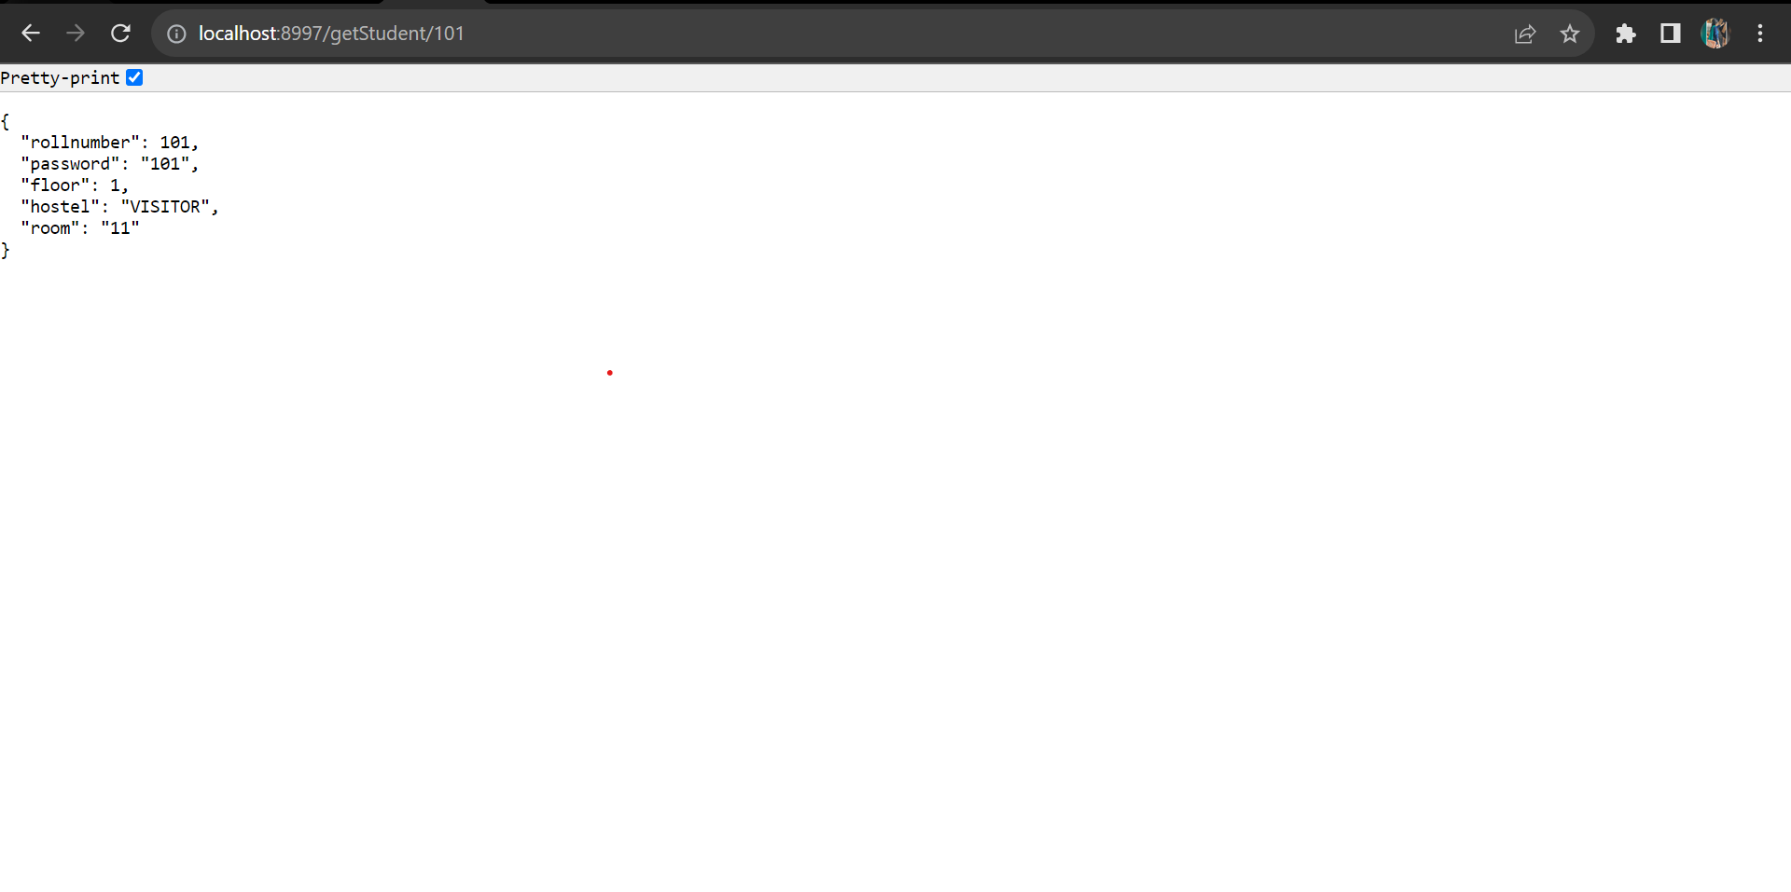
getStudent/101

Slide 22
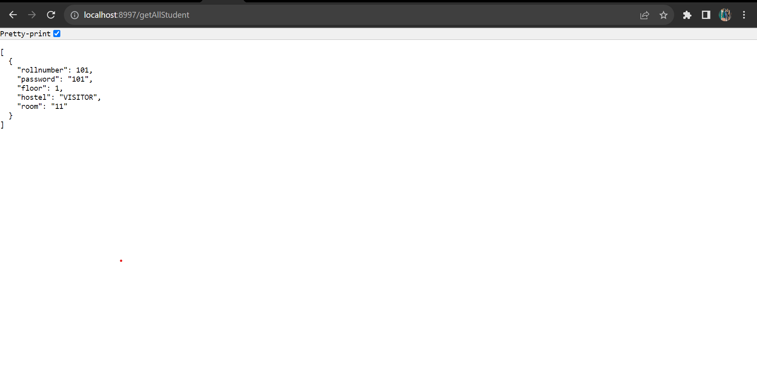
getAllStudent

Slide 23
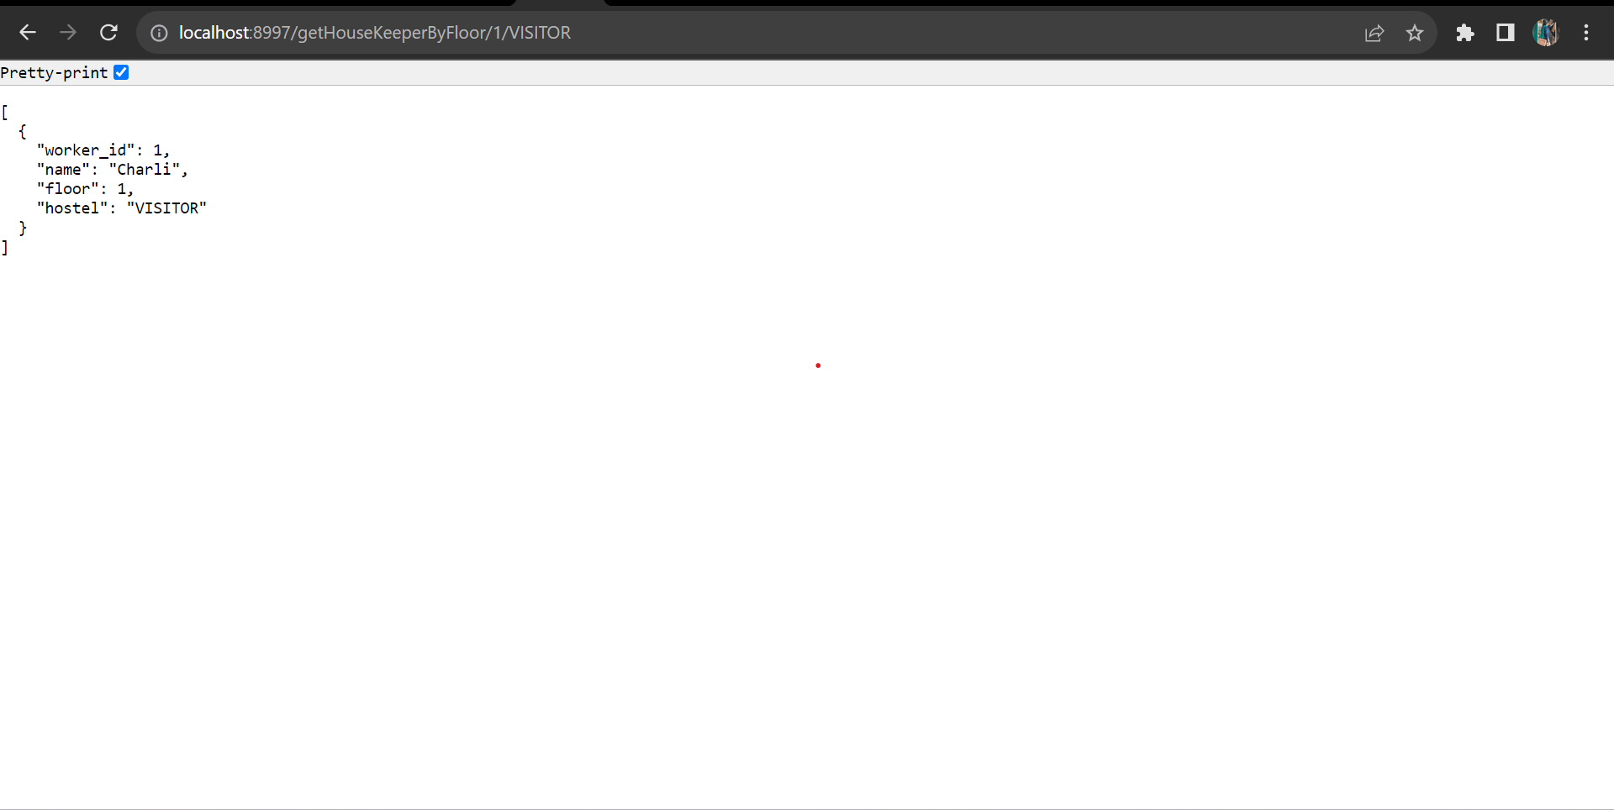
getHouseKeeperByFloor/1/VISITOR

Slide 24
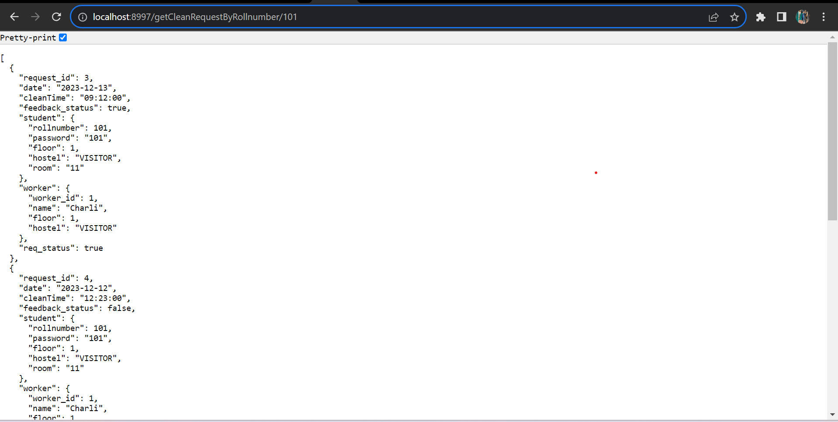
getAllCleanRequestByRollnumber/101

Slide 25
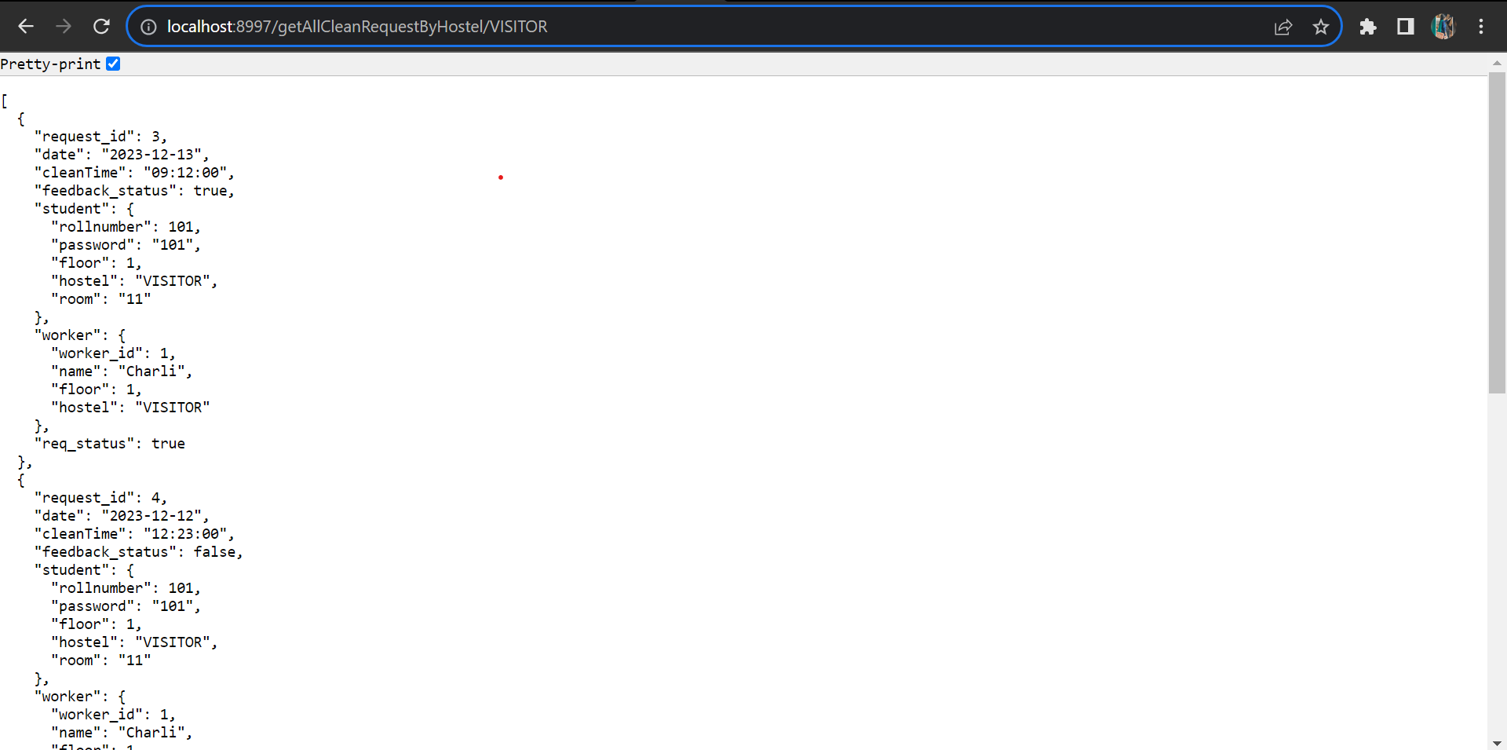
getAllCleanRequestByHostel/VISITOR

Slide 26
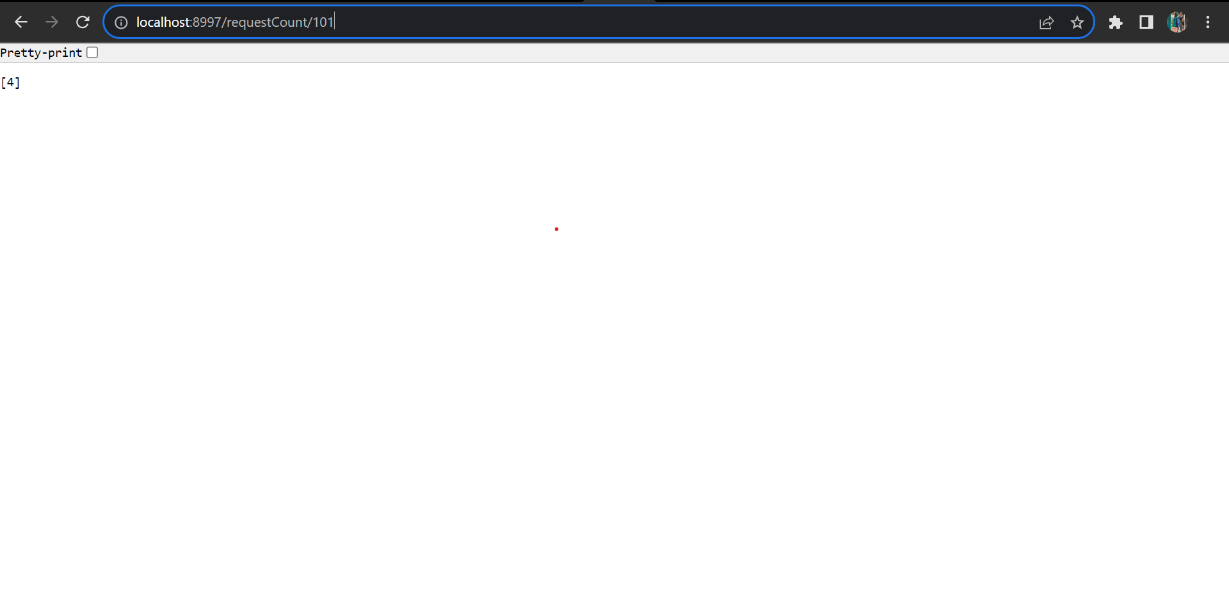
requestCount/101

Slide 27
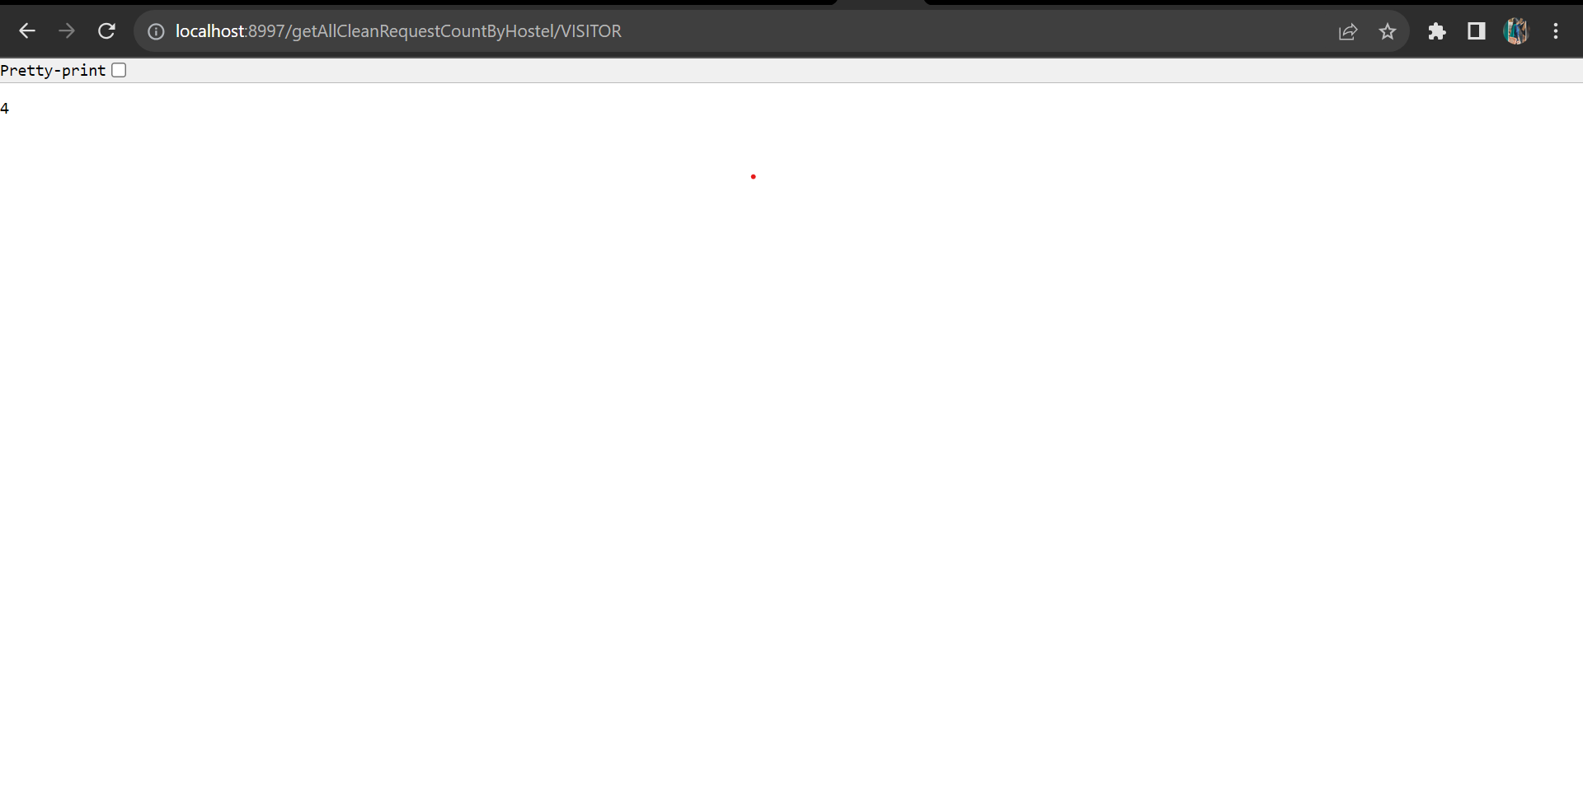
getAllCleanRequestCountByHostel/VISITOR

Slide 28
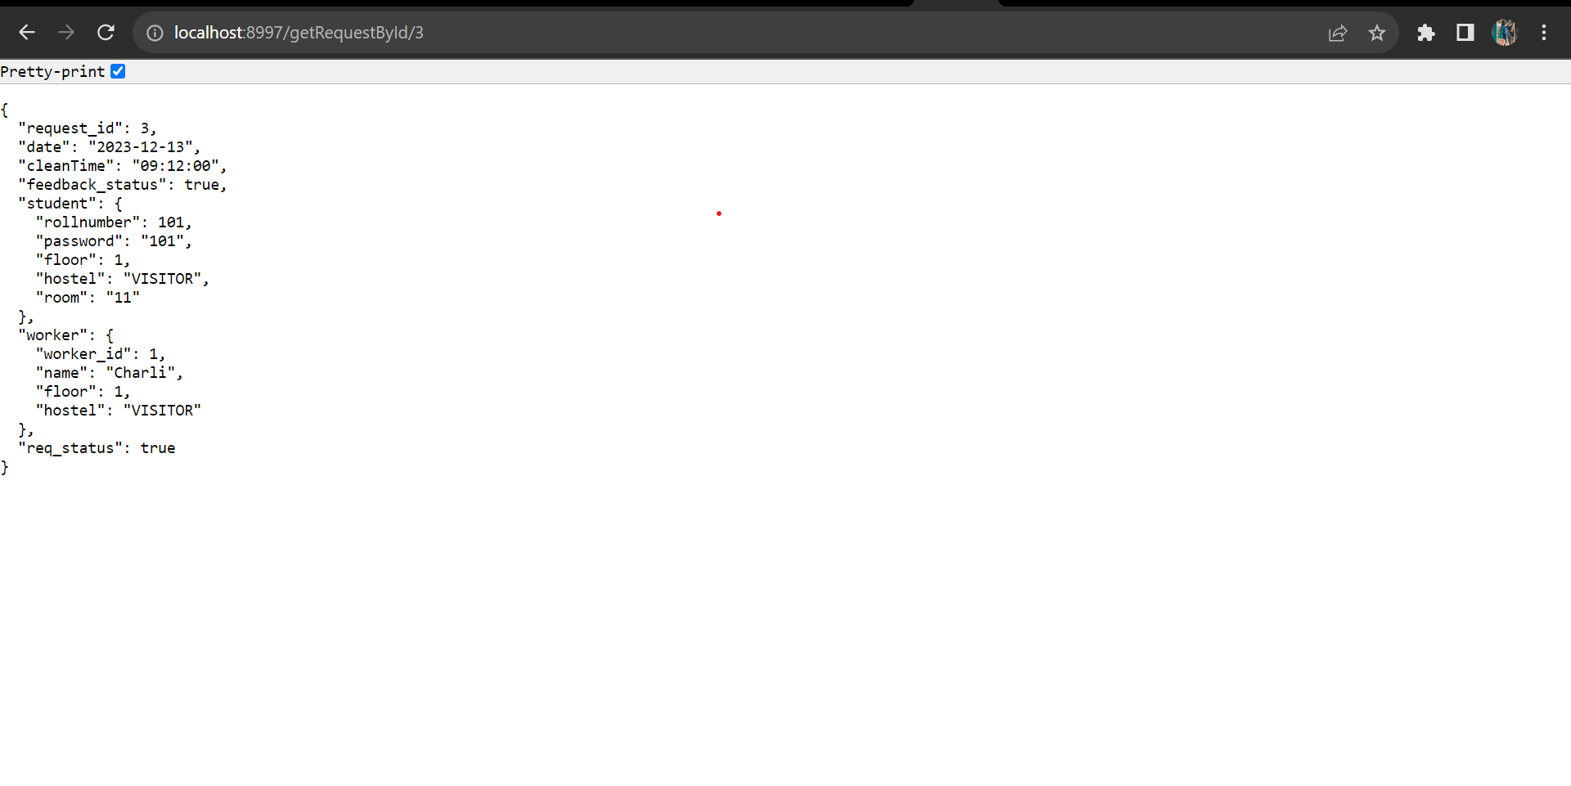
getRequestById/3

Slide 29
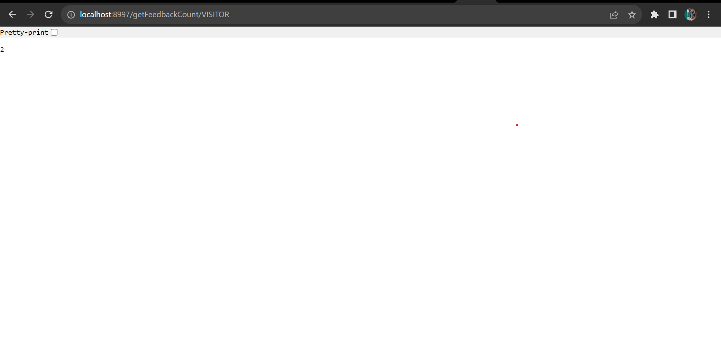
getFeedbackCount/VISITOR

Slide 30
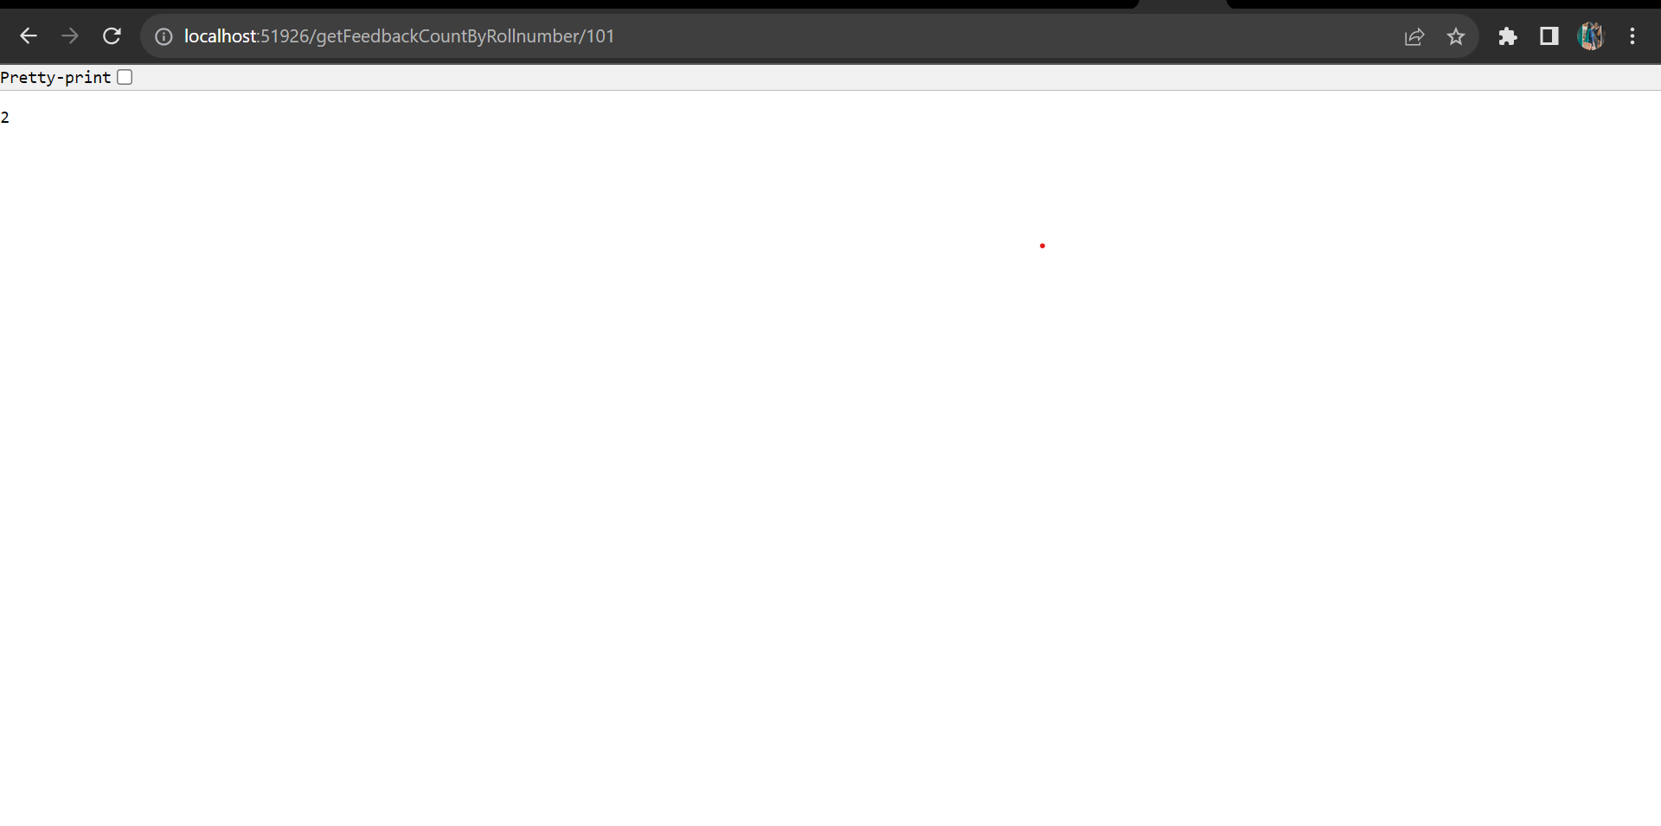
getFeedbackCountByRollnumber/101

Slide 31
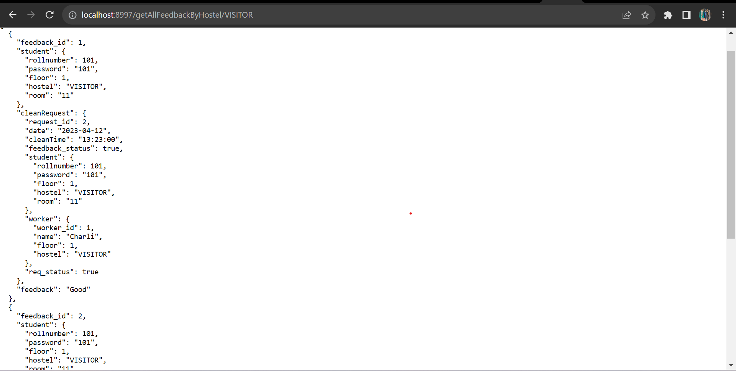
getAllFeedbackByHostel/VISITOR

Slide 32
Conclusion
This project exemplifies the power of technology in transforming traditional processes and creating a more convenient and effective environment for both students and hostel management.
From the management's perspective, this application will enhance the efficiency of cleaning service utilization, reducing the occurrence of improper scheduling and optimizing resource allocation.
The application's rich features will empower students to easily request cleaning services, select preferred time slots, and receive timely notifications and updates regarding the cleaning process.

Slide 33


